Slide 1

Fostering A Positive Research Culture Around Interdisciplinary Research
Cristina V. Martin

Slide 2

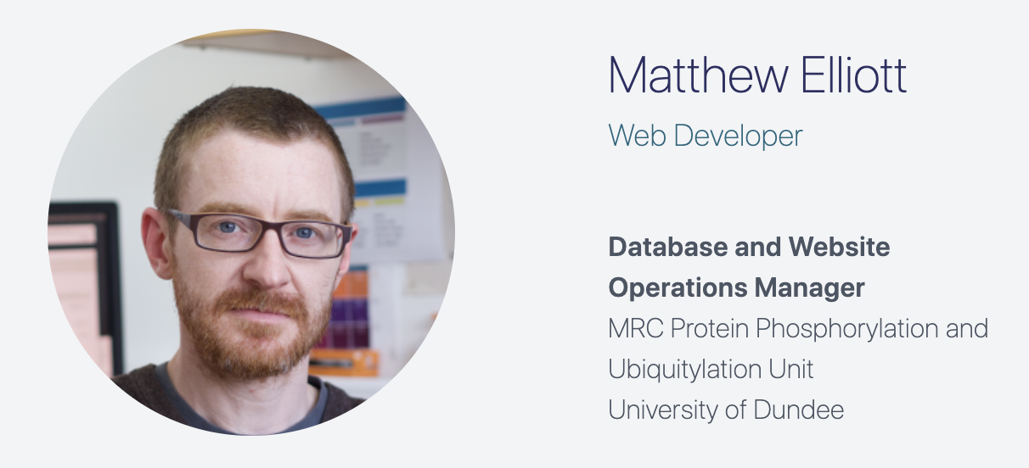

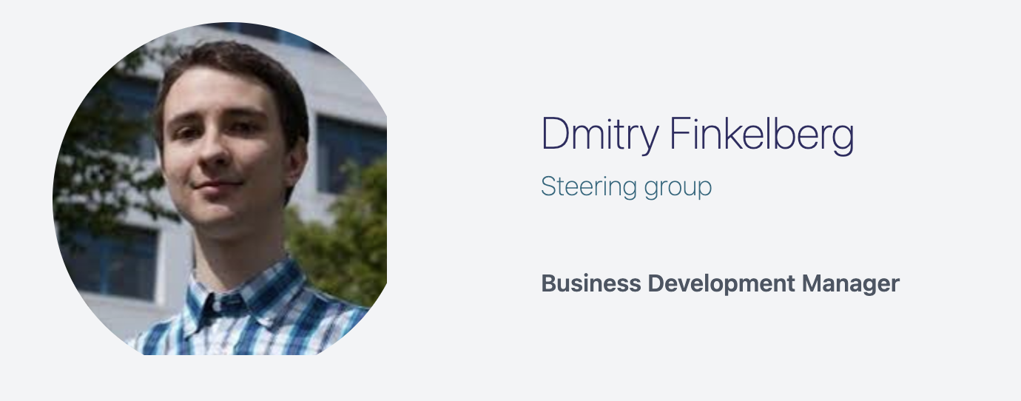

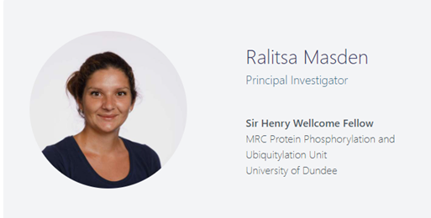


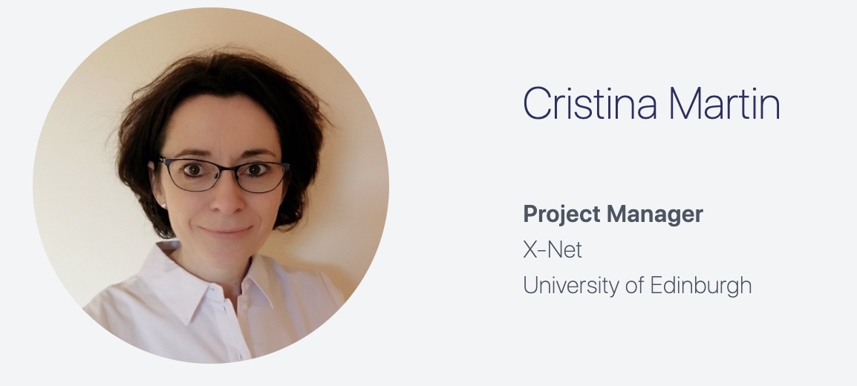



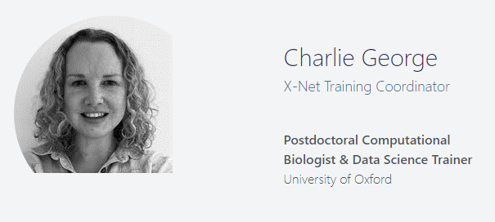
X-Net group members

Slide 3
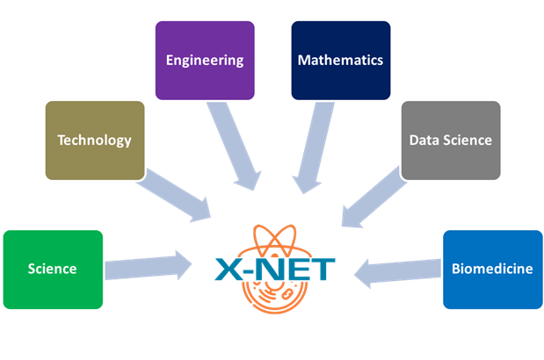

X-Net Aims
Establishment of a network: of interdisciplinary researchers at different career stages. Involvement of industry and PPI.
Making recommendations to funding bodies and policy makers: by gathering data from the network, identifying the main barriers and the drivers affecting cross-disciplinarity.

Slide 4


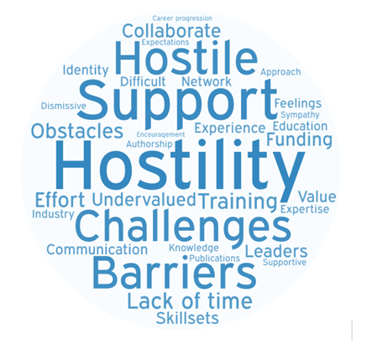
Methodology to establish the network
and gather evidence
Workshops
Interdisciplinarians: “Overcoming Barriers to Cross-Disciplinary Research” (July 2022)
Industry: “Preparing the roadmap: prioritising cross-disciplinary training needs with industry” (January 2023)
PPI: “Creating & Nurturing Diverse Teams for Effective Biomedical Science“ (June 2023)
EDI: “Lessons from equality, diversity, and inclusion: How might interdisciplinary research culture evolve and be strengthened?” (January 2024)
Surveys
Identifying barriers to cross-disciplinary researchers (August 2022)
Over 60% of the researchers experienced a negative environment when crossing disciplines.
REPORTS
https://x-net.bio

Slide 5
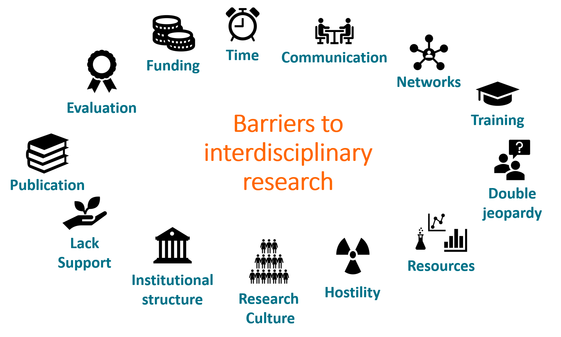
Obstacles faced by interdisciplinarians

Slide 6



Slide 7
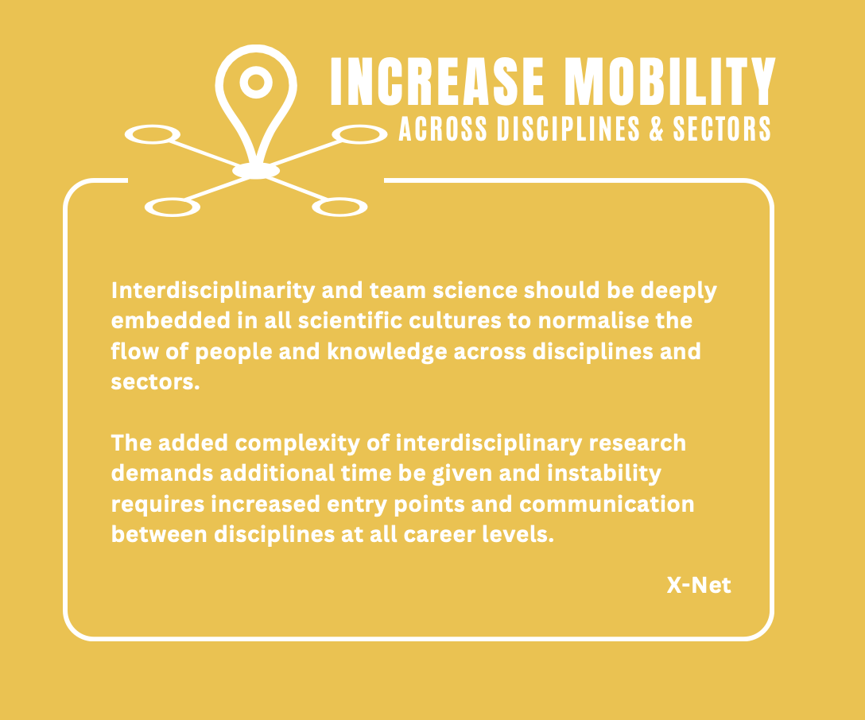
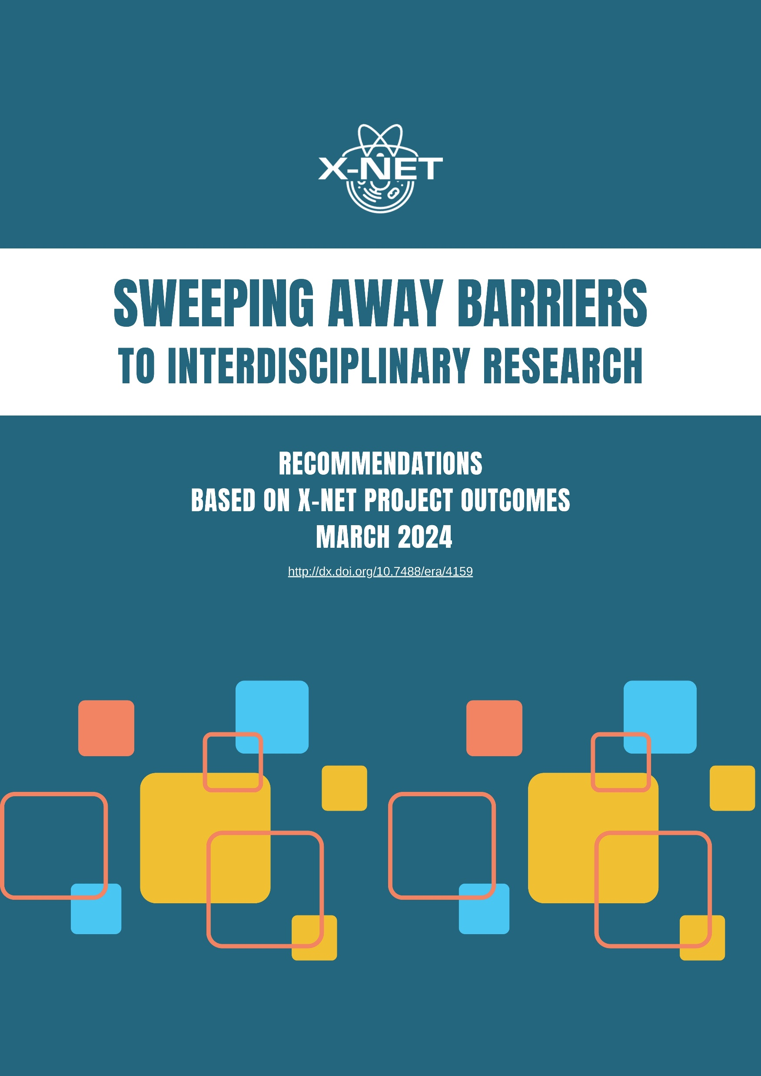
Enable pivot fellowships at any career level.
UK-wide fellowships to fast-track talented researchers across poorly permeable disciplinary boundaries.
Incentivise team science & network building by actively providing “first step” training opportunities.
Active co-supervision of early career researchers or technicians working on interdisciplinary projects by investigators from different disciplines.

Slide 8
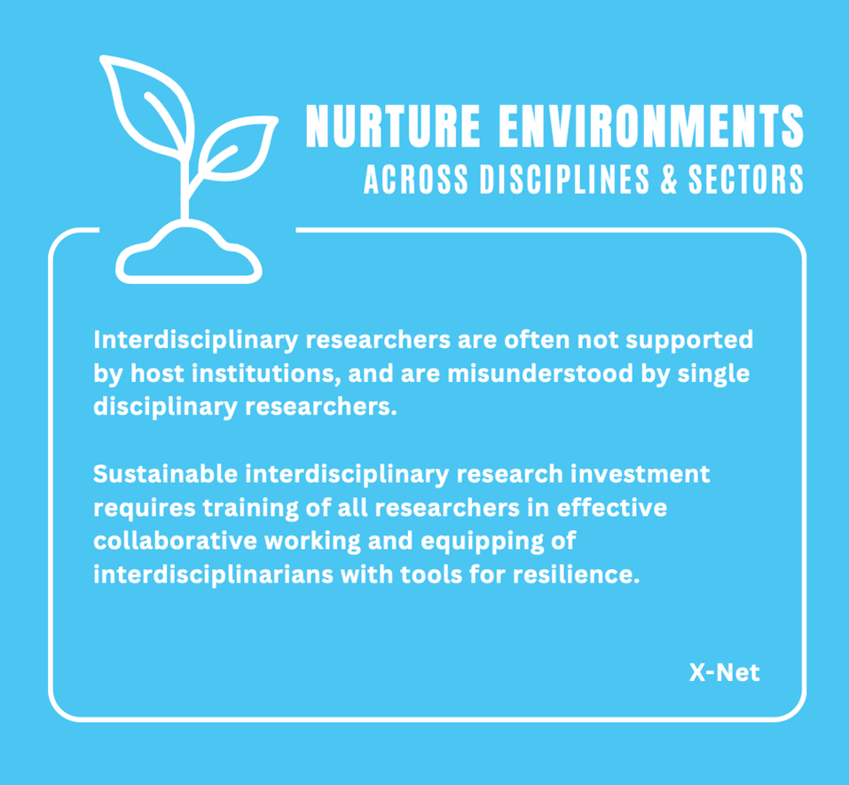
Build cohorts of researchers and sustain them with networking and mentoring events.
Draw up a code of conduct to outline responsibilities and expectations for collaborations.
Promote training in interdisciplinarity for all researchers about the advantages, challenges, and values of interdisciplinary collaboration.
Extend continuous training opportunities, currently limited to doctoral students.

Slide 9

Prioritise funding to interdisciplinary projects when panel scores are tied.
Recognise and allow for longer timeframes required for interdisciplinary training and outcomes.
Assess team and interdisciplinary science commitment in collaborative applications.
Enable flexibility of authorship ordering to remove ingrained bias.
Proportional funding panels with interdisciplinary members in proportion to the interdisciplinary proposals assessed.

Slide 10
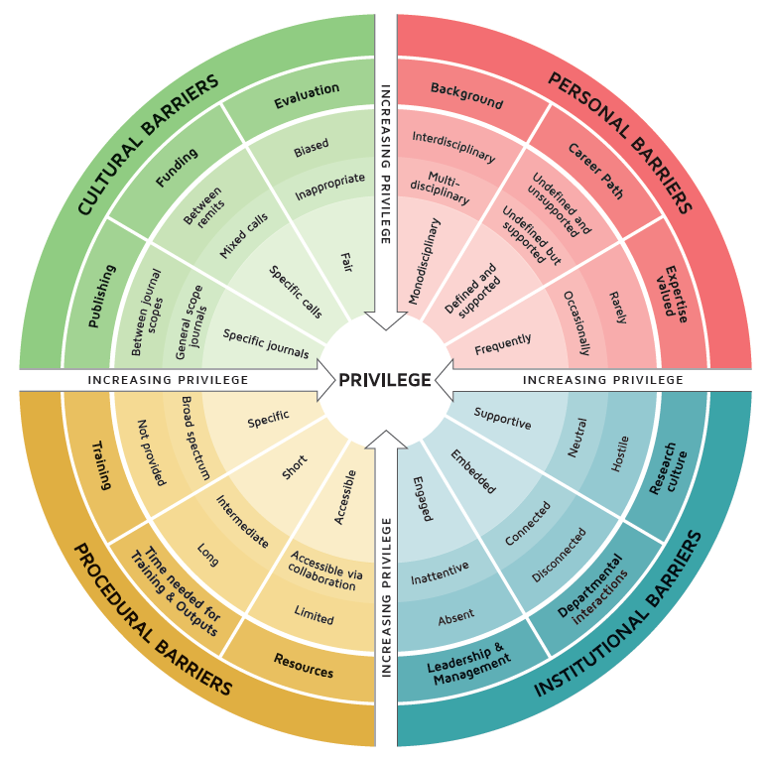
Interdisciplinary Research Wheel of Privilege

Slide 11





Strategies to foster a positive research culture in interdisciplinary research
Recognition and awards
New concept of leadership
Building external connections
Generosity and hospitality
Research
Culture

Slide 12





InFrame
New leadership model
University of Edinburgh
University of St Andrews
University of Glasgow
Widen leadership recognition
Champion collegiality and inclusion
Change traditional hierarchies

Slide 13
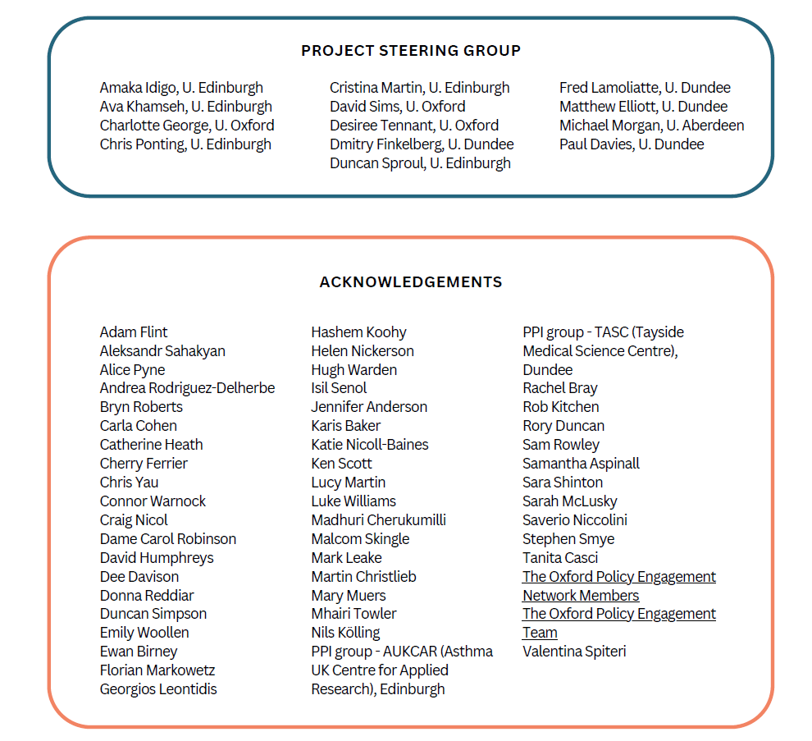

X-Net’s acknowledgements
https://x-net.bio

Slide 14
Fostering A Positive Research Culture Around Interdisciplinary Research
Cristina V. Martin

